Slide 1

Final Project Presentation
By: Gavin Binder, Joshua Mammah, Charles Ireland, and George Roig

Slide 2
Introduction
The video games industry has become so large that its revenues pull in more than movies and music combined, making it an essential part to our society. Using the `video_games.csv` data set from TidyTuesday, we are going explore some characteristics of video games including:
How does price affect metacritic score?
What are the correlations between the year a game was released and the price of a game?

Slide 3
Background knowledge
Our data set put together by TidyTuesday and includes roughly 9000 video game titles, alongside their price, owners (sales), developer, developer, publisher, average and median playtimes, and metascore.
We used the following packages for our project:
Tidyverse
deplyr
ggplot2
Lubridate

Slide 4
Data Set
First, we imported the data set from TidyTuesday, setting it to `games` and then we created a new column called ‘meta_rating_class’ to give the meta rating alongside the games with an available metascore. The classification system goes by the following:
Universal Acclaim: 90-100
Generally Favorable: 75-89
Mixed/Average: 50-74
Generally Unfavorable: 20-49
Overwhelming dislike: 0-19
We also had to use mutate to split the release date column into three new columns, year, month, and day to make it easier when answering our second question.

Slide 5
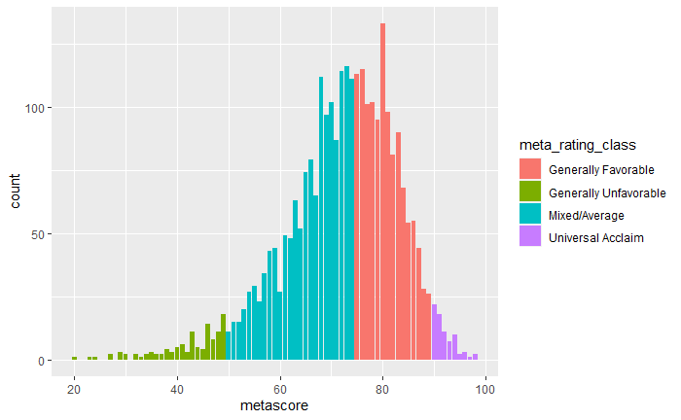
Data Exploration for metascore distribution
As we can see from the bar plot, most of the games tend to be in mixed/average or generally favorable, with very few games being generally unfavorable or universally acclaimed:

Slide 6
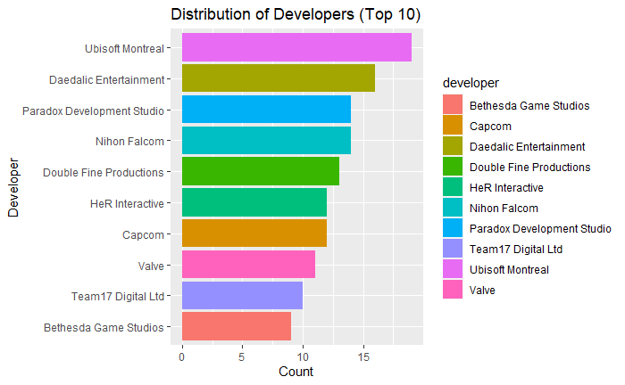
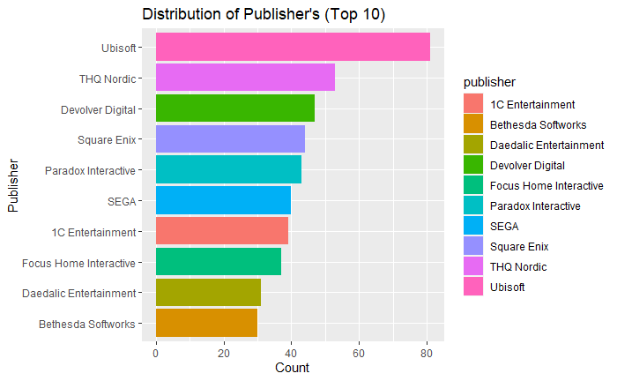
Data Exploration for Distribution of Top 10 Publishers and Developers
We then looked at the distribution of games by developer and found that Ubisoft Montreal has developed a substantial number of games. We also looked at the distribution for publishers and found that Ubisoft stays on top for both number of games developed and published.

Slide 7
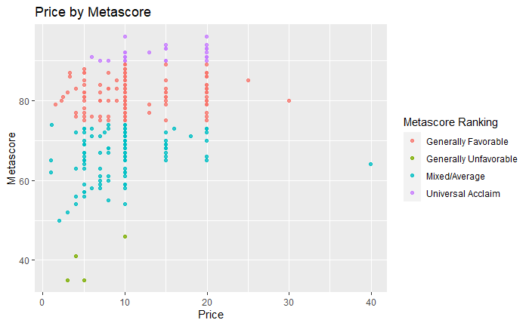
Exploring Game’s Price by Metascore
Here, we did some multivariate exploration to visualize the correlation between price and metascore. We had to use the slice function to reduce the number of games to about 300 to lessen clutter.

Slide 8
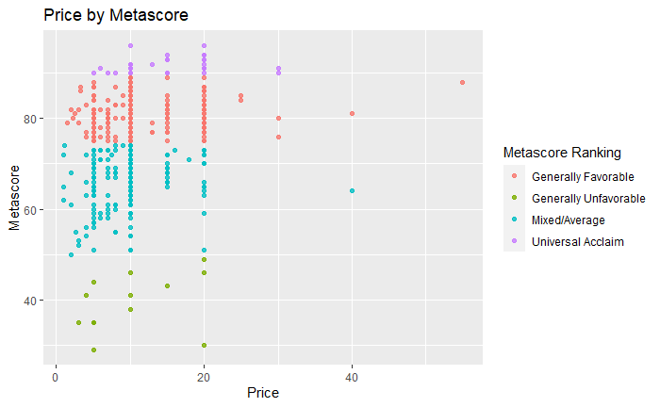
Analysis for question 1
To answer the question “How does price affect metacritic score?”, we used the same scatter plot that we analyzed during our multivariate exploratory data analysis. From a sample size of 500, we can see that generally price doesn’t affect metascore that much. Just looking at a price of 20, we can see games both above 90 and blow 40. However, there is a small correlation in that generally unfavorable games do not go past 20, while some other rankings do.

Slide 9
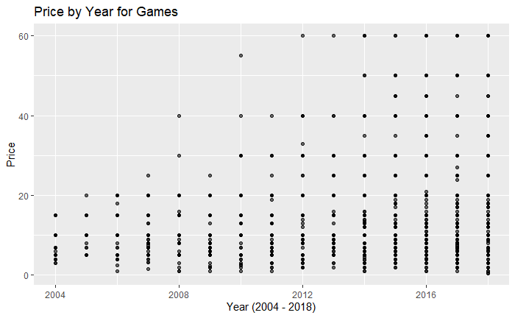
Analysis for question 2
For the question “What are the correlations between the year a game was released and the price of the game?”, we created a scatter plot and found that there is a clear correlation between the year a game was released and its price. Prices for games have gotten significantly higher due to increased costs in game development over the years. This results in many more games at much higher price points towards 2017 and 2018.

Slide 10
Conclusion
In our research, we have learned that price had little to no correlation on metascore, but as the years progressed the prices for games have greatly risen with no signs of stopping. We have also learned how to improve our research to possibly use for a project for next time, such as improving the way that we use graphs by adding better aesthetics or including more multivariate exploration to ask more complex questions and understand our data more.

